Slide 1


Final Design presentation
3D Filament Drive
Brenner Craft, Xander Curry, Jacob Miller, Sam Smith
Notes:
Jacob

Slide 2
Overview
Problem Statement
Proposed Solution
Design For:
Tradeoffs
Performance Specifications
Design Evaluation
Predicted Performance
Probability of Success
Schedule
Budget
Next Steps
Notes:
Sam

Slide 3

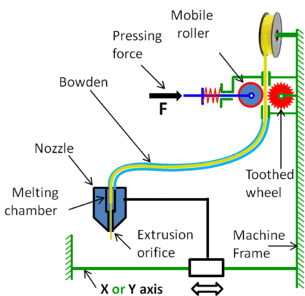
Problem statement
MEX 3D printers do not account for variation in filament diameter
MTDG believes diameter variation leads to waste
MTDG & BREL want to solve this problem for MEX 3D printers
[1] M. Boulaala, Basic Diagram of FDM 3D Printer Extruder. (a) Direct Extruder. (b) Bowden Extruder. Research Gate, 2020. https://www.researchgate.net/figure/Basic-diagram-of-FDM-3D-printer-extruder-a-Direct-extruder-and-b-Bowden-extruder-15_fig3_376519104
Notes:
Brenner

Slide 4
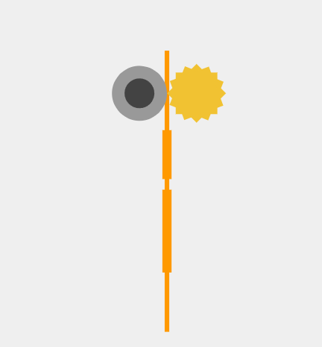
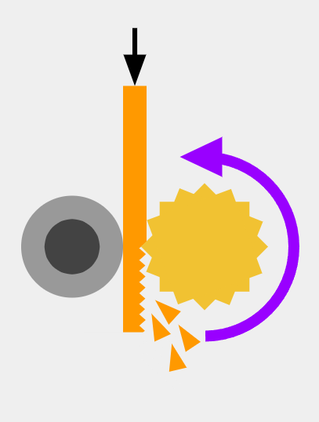
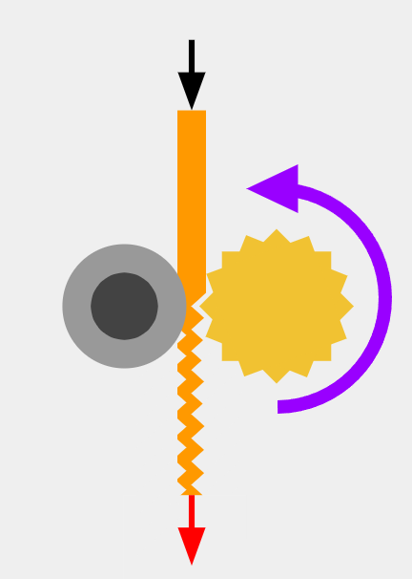
Problem Visualization
Filament Variation
Insufficient Pressure
Excessive Pressure
Constant variations in filament
Severity of variations unpredictable
Filament grinding and slipping
Incorrect amount of material being extruded
Filament crushed and elongated
Added strain on extruder stepper motor
Notes:
Brenner

Slide 5
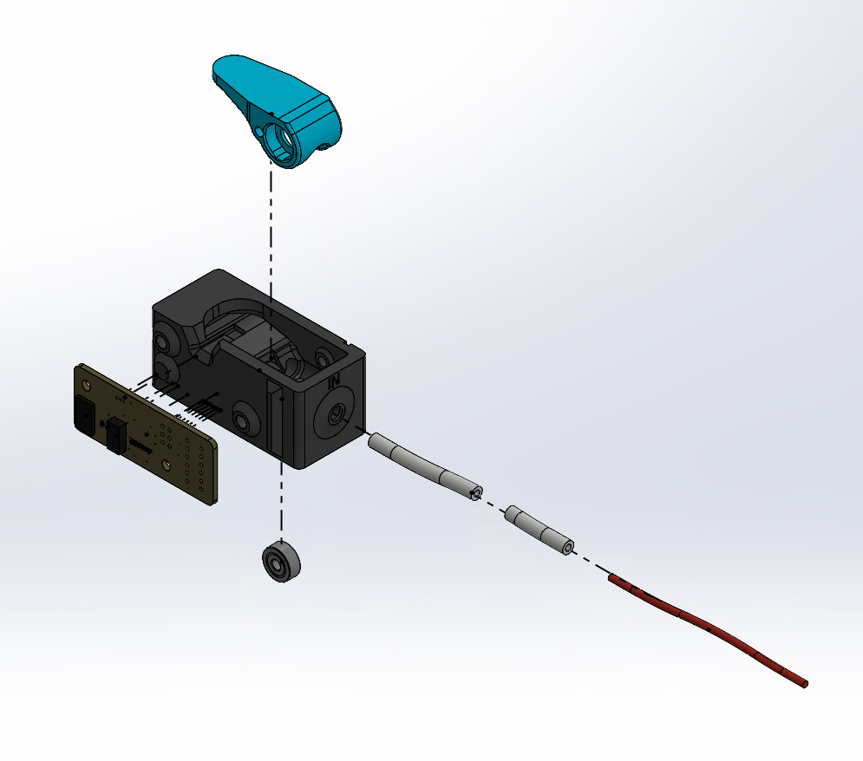
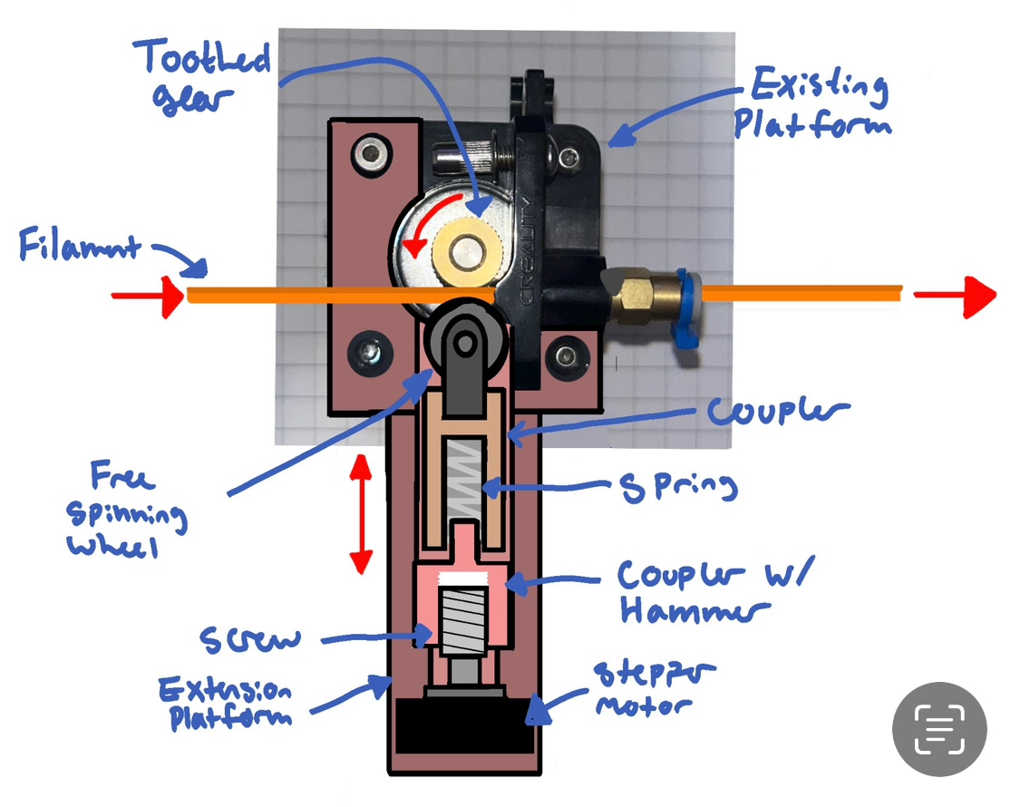
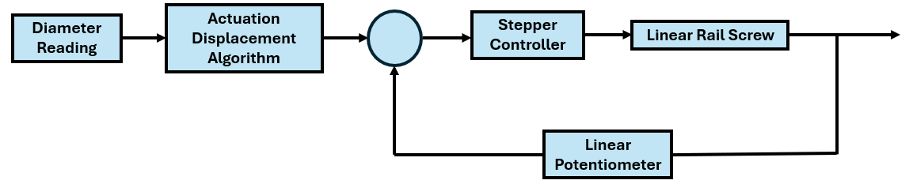
Proposed Solution
Initial Concept
Explanation
1st Model Drawing
Filament diameter sensor developed by Thomas Sanladerer
Premade linear rail for force application
Linear potentiometer & limit switch for position detection & closed loop control
Notes:
Brenner

Slide 6
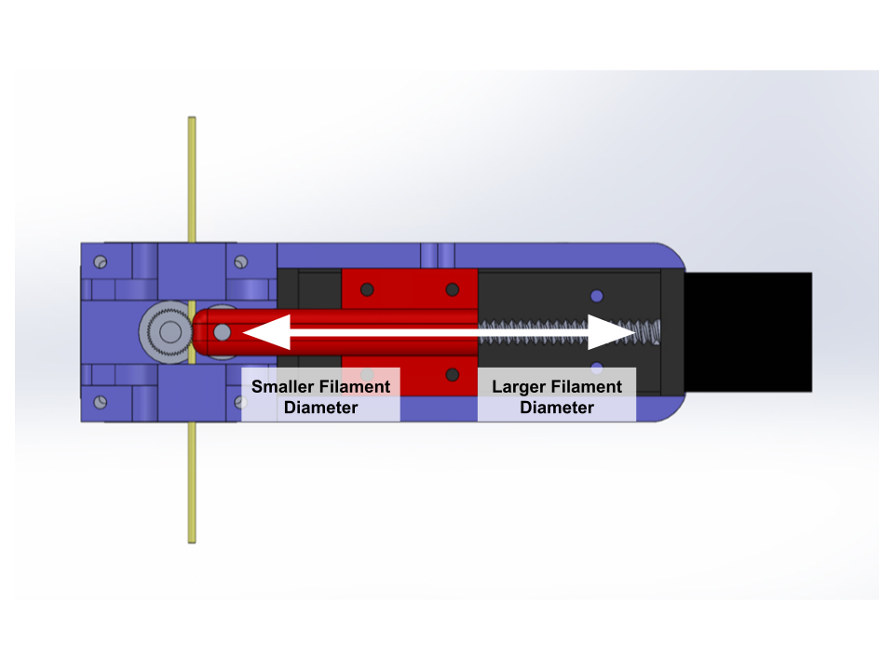
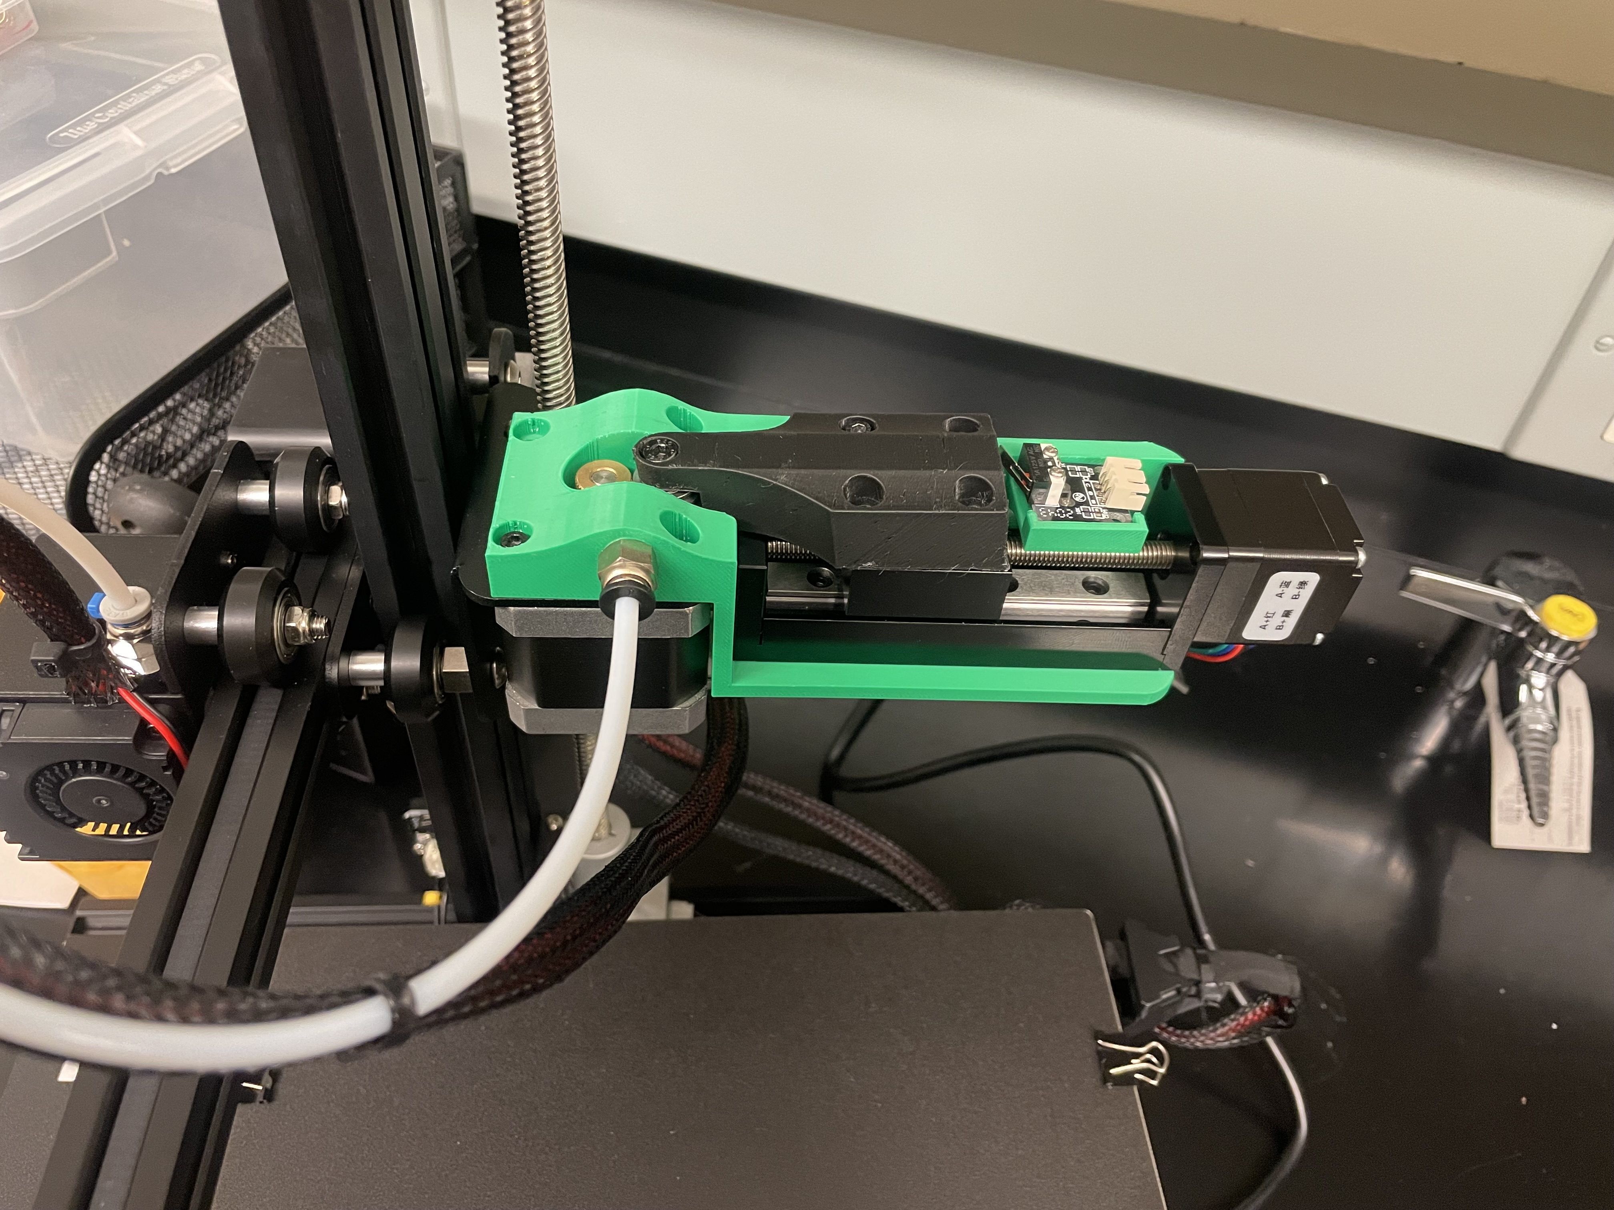
Proposed Solution
1st Prototype
Pros & Cons
A
Pros
Simple design
Position detection system worked well
Cons
Control system unable to measure exact force on filament
Cantilever form led to vibrations
Notes:
Brenner

Slide 7
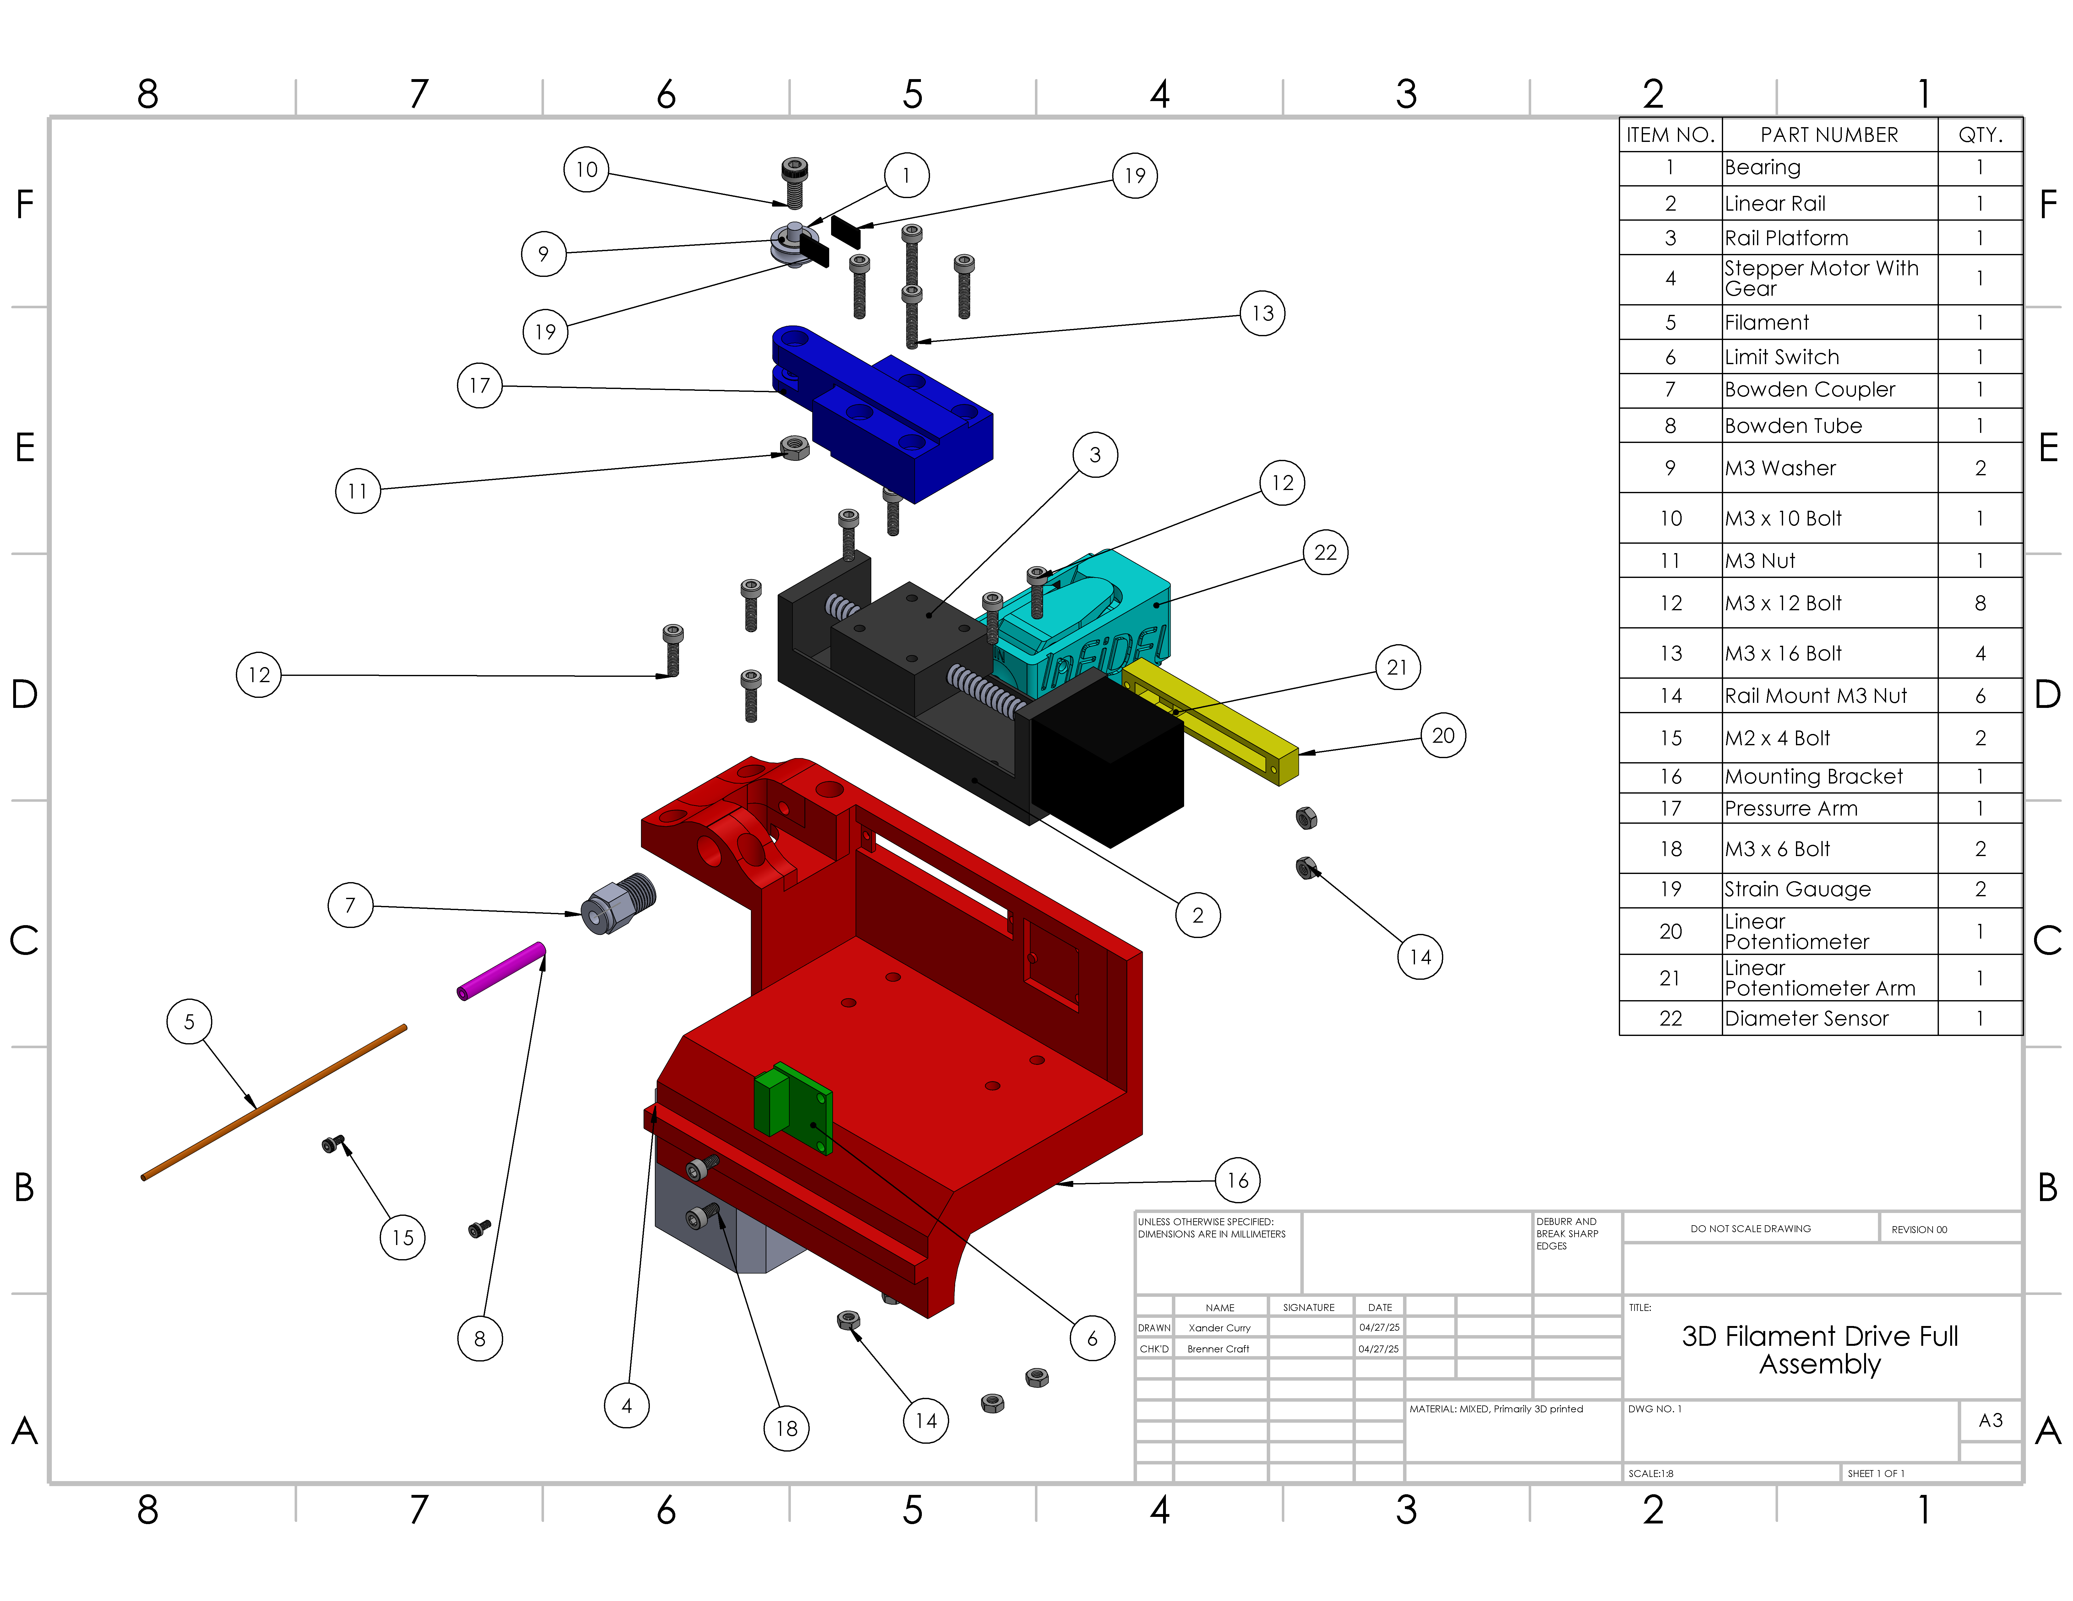
Final Prototype
Mechanical Systems
Mechanical
Custom components 3D printed
Mounting body for linear rail
Calibrated pressure arm
Filament diameter sensor housing/lever
50mm premade linear rail with 0.1mm precision
Printer's stock Nema 17 extruder motor
Pressure Arm
Digital End Stop
Main Housing Body
Precision Linear Rail
Linear Potentiometer
Extruder Stepper Motor
Notes:
Sam

Slide 8
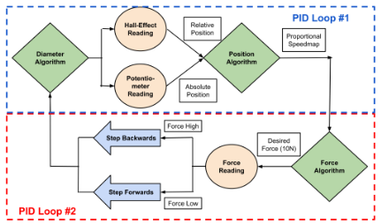
Final Prototype
Electrical Systems
Electrical
Broad sensor array for closed loop control
Hall-effect sensor
Digital endstop
Linear potentiometer
Strain gauges
PID Loop #1
Takes diameter reading/needed position & compares to current location
Sets speed based on difference and moves to needed position
PID Loop #2
Takes force reading from strain gauge and compares to desired force
Steps rail forwards or backwards to compensate
Pressure Arm
Digital End Stop
Main Housing Body
Precision Linear Rail
Linear Potentiometer
Extruder Stepper Motor
Notes:
Sam

Slide 9
Design For- Additive Manufacturing
Maximized use of "free" complexity
Designed for minimal support structure and waste
Optimized component sizing for AM production
Notes:
Sam

Slide 10
Design For- Assembly
Minimized number of components
Designed to align in a single orientation
Installed in printer's pre-existing mounting locations
No specialty tools required
Notes:
Sam

Slide 11
Design For- Safety
Low Voltage
Reduced number of failure modes
Easy accessibility for maintenance and repairs
Open design for visual inspection
Notes:
Sam

Slide 12
PERFORMANCE SPECIFICATIONS
Precision
Fast Response Time
Easy Assembly
Small Size & Lightweight
Maximize Lifespan
Importance
Notes:
Brenner

Slide 13
TRADEOFFS
Specification 1 | Specification 2
Precision | Response Time
Size | Build Difficulty
Precision | Size
Lifespan | Weight
Notes:
Sam

Slide 14
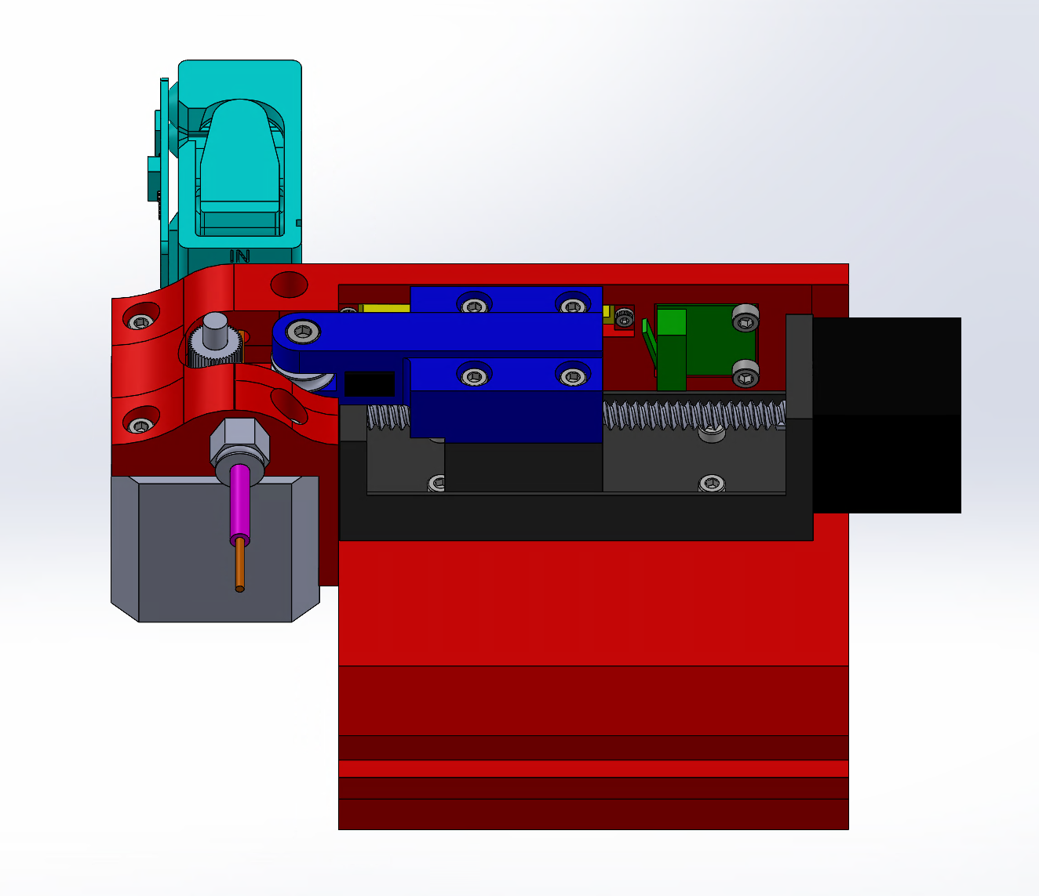
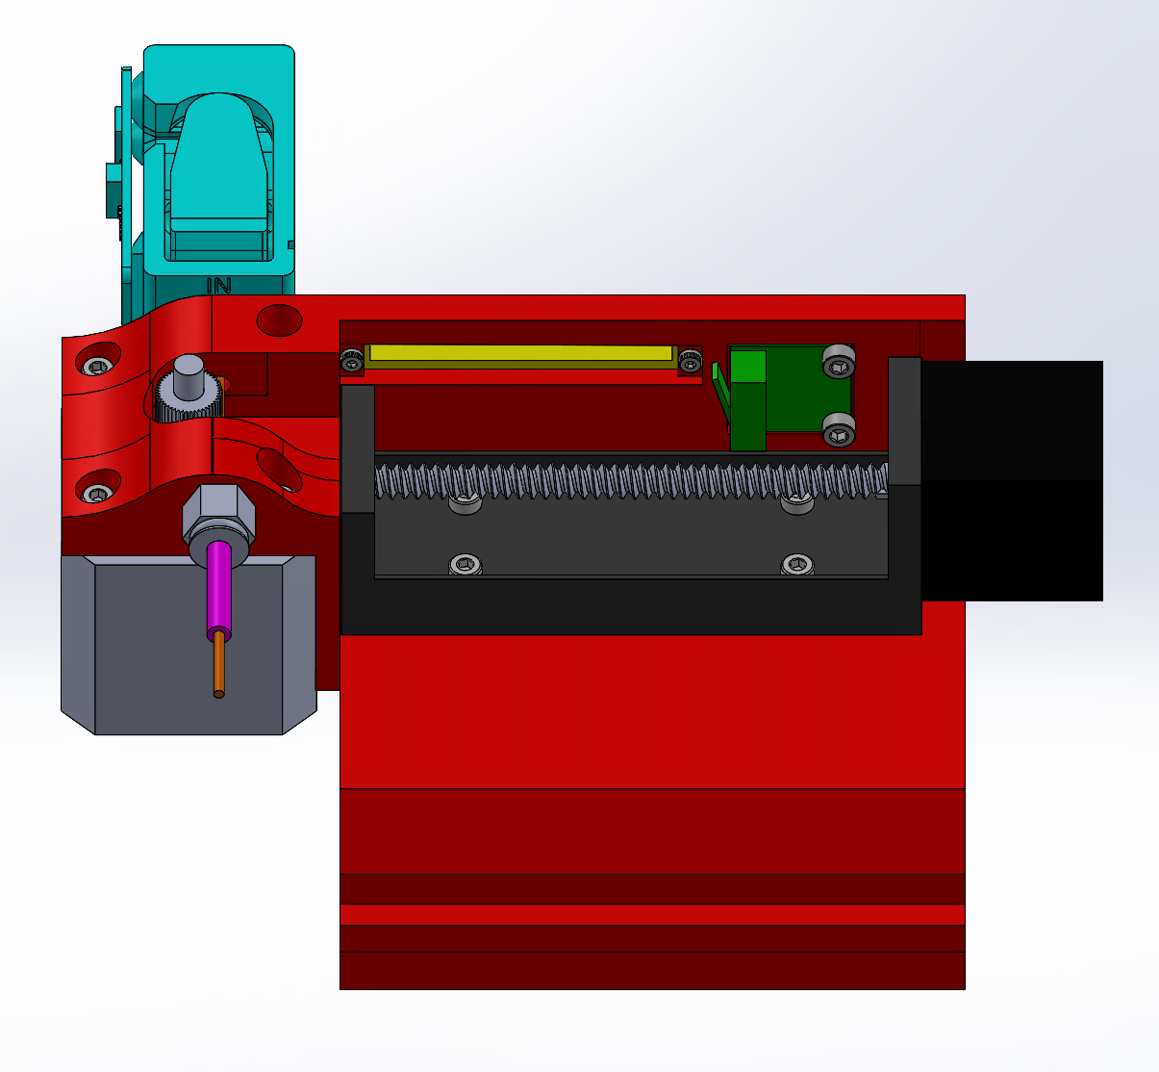
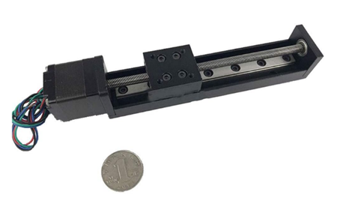
Predicted Performance
Precision
Designing for precision
Leadscrew based actuator
Common in CNC machines, known for high precision
Premade linear rail further increases precision
Using closed-loop control
Values constantly revalidated to determine exact position
Utilizes variety of sensors:
Linear potentiometer, limit switch, strain gauges, & hall-effect sensor
[2] "Linear Actuator Stepper Motor for CNC Milling Machine," Amazon. [Online]. Available: https://www.amazon.com/Linear-Actuator-Stepper-Milling-Machine/dp/B07K7FWDZJ?th=1. [Accessed: Dec. 5, 2024].
Notes:
Xander

Slide 15
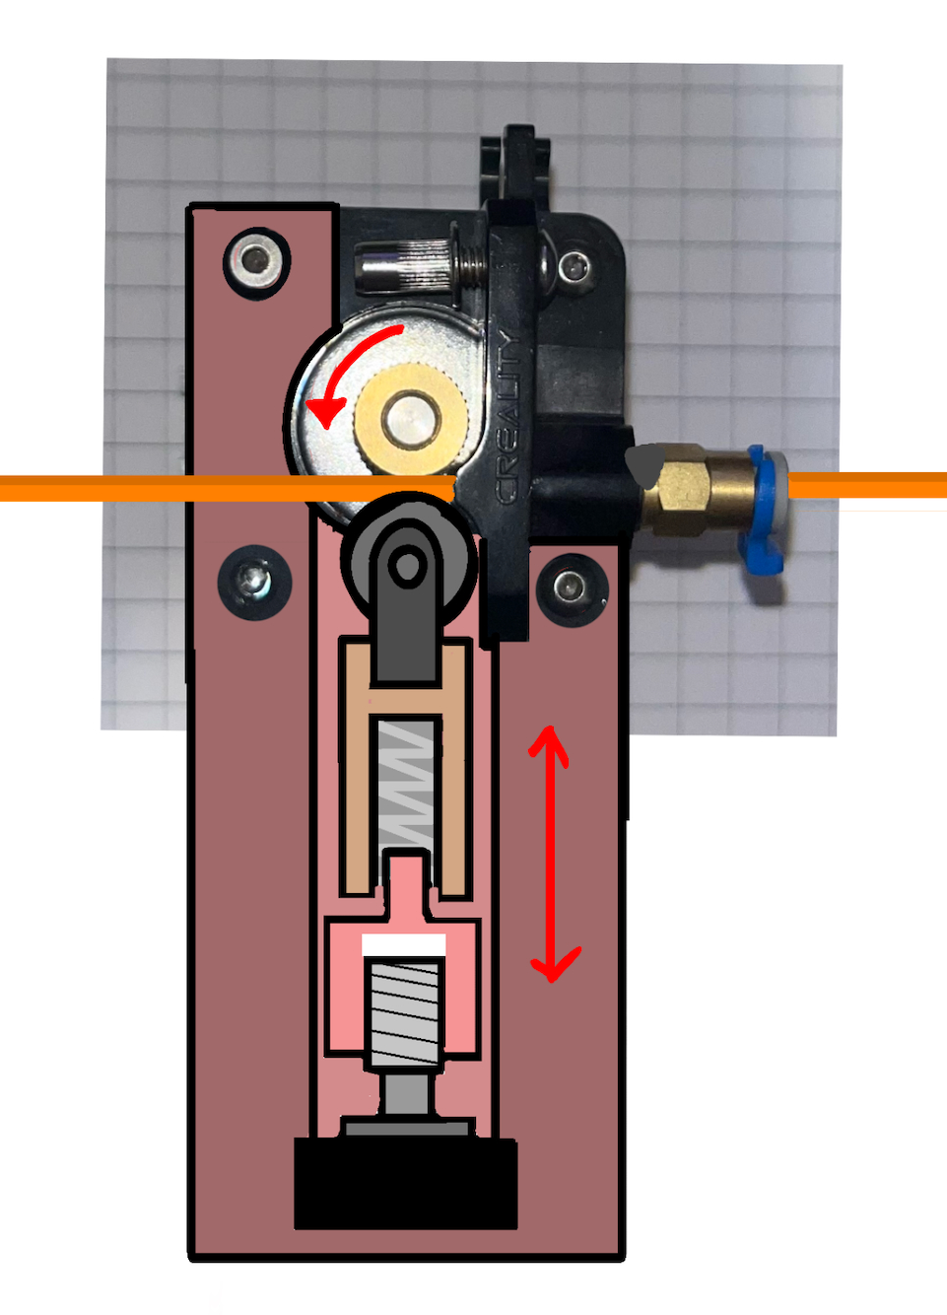
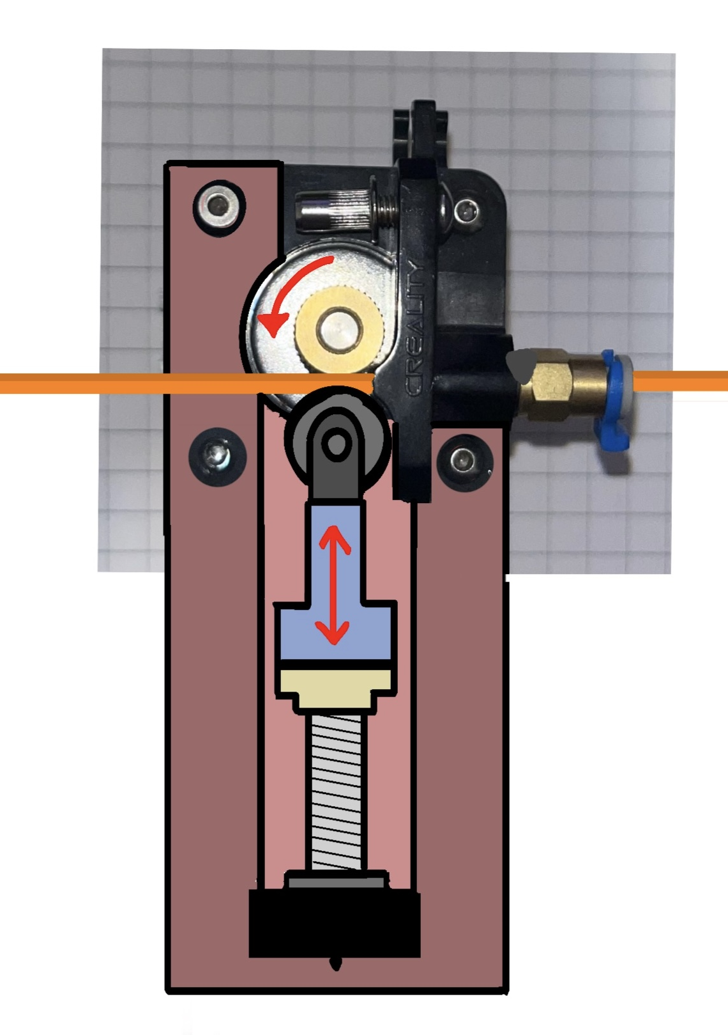
Predicted Performance
Easy Assembly
Designing for Ease of Assembly
Spring mechanism removed
Less design complexity & easier assembly
All electronics connected to single microcontroller
Connected to pre-existing power supply
Reduce overall number of parts
1st Prototype
Revised Prototype
Notes:
Xander

Slide 16
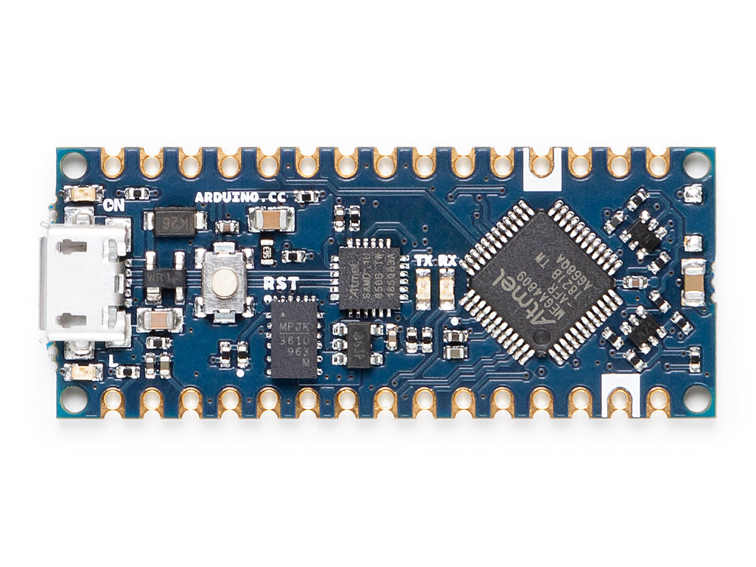
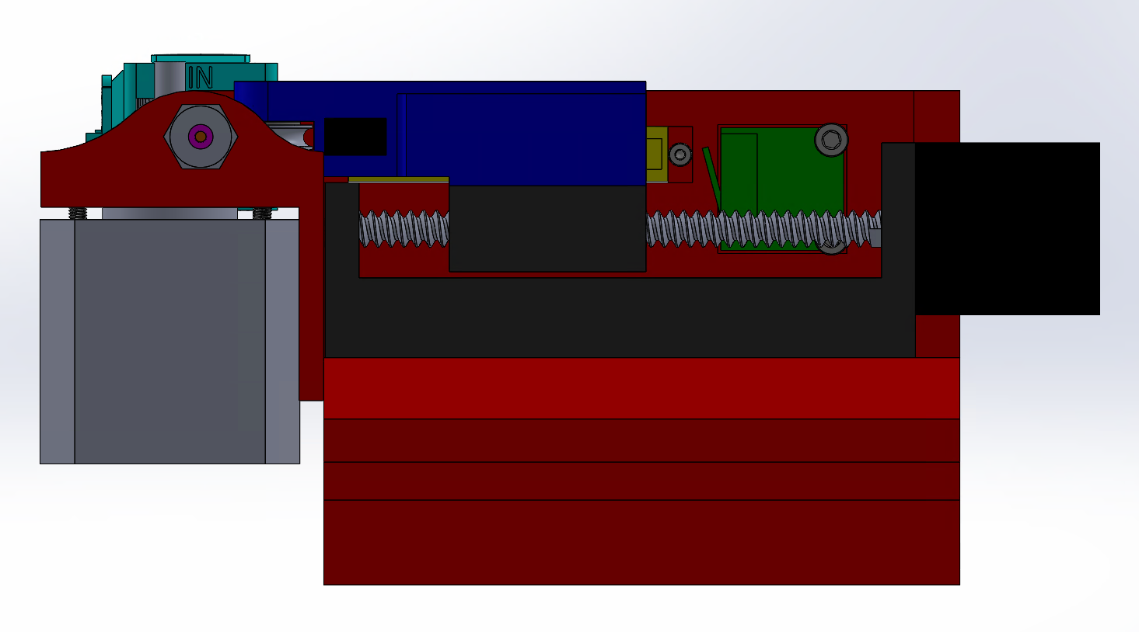
Predicted Performance
Fast response Time
Designing for Fast Response Times
Using Arduino Nano
Clock speed of 16 MHz
Processes data faster than filament extrusion
Spring mechanism removed
Fewer components in compression system ensures faster response time
Actuation System Selection
Small sized linear rail system operates at sufficient speed and precision
[3] “Arduino Nano,” Arduino Official Store, 2020. https://store.arduino.cc/products/arduino-nano?srsltid=AfmBOoq5md7oHKH53XCXMR7HcQrfkx_0XXJAZi-3u9X6VRjrlWzu-RHk (accessed May 01, 2025).
Notes:
Xander

Slide 17
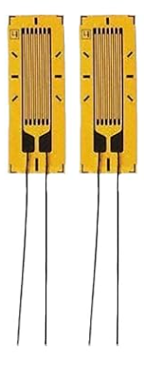
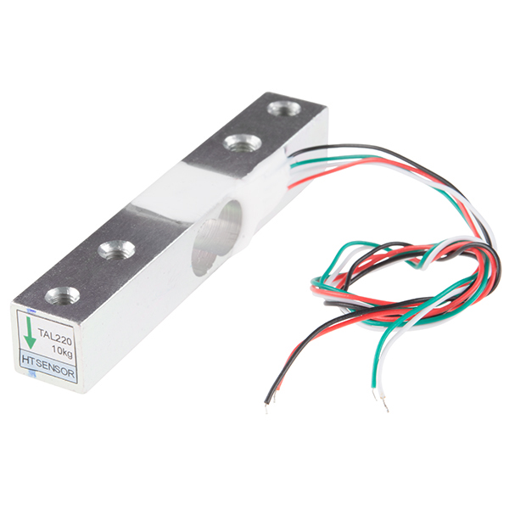
Predicted Performance
Small Footprint & Lightweight
Designing for Reduced Footprint & Weight
Premade 50 mm linear rail actuator
Significant weight and size reduction compared to common 100 mm systems
Initial sensor selection changed
Large load cell bar replaced with smaller strain gauges
Utilizing existing supply-maintained footprint and weight
[4] Culler. Strain Gauge Used in Mechanics Experiment for Material, Industry, or Science. Amazon, n.d., www.amazon.com/dp/B07P8HBPGR.
[5] SparkFun Electronics. Load Cell - 10kg, Straight Bar (TAL220). SparkFun Electronics, n.d., https://www.sparkfun.com/load-cell-10kg-straight-bar-tal220.html. Accessed 1 May 2025.
Notes:
Xander

Slide 18
Predicted Performance
Maximize Lifespan
Designing for Long Lifespan
Inclusion of redundant sensors
Limit switch and linear potentiometer used for position sensing
Closed-loop control
Reduces likelihood of mechanical failures
Changed orientation for less stress on Z-axis screw
Notes:
Xander

Slide 19
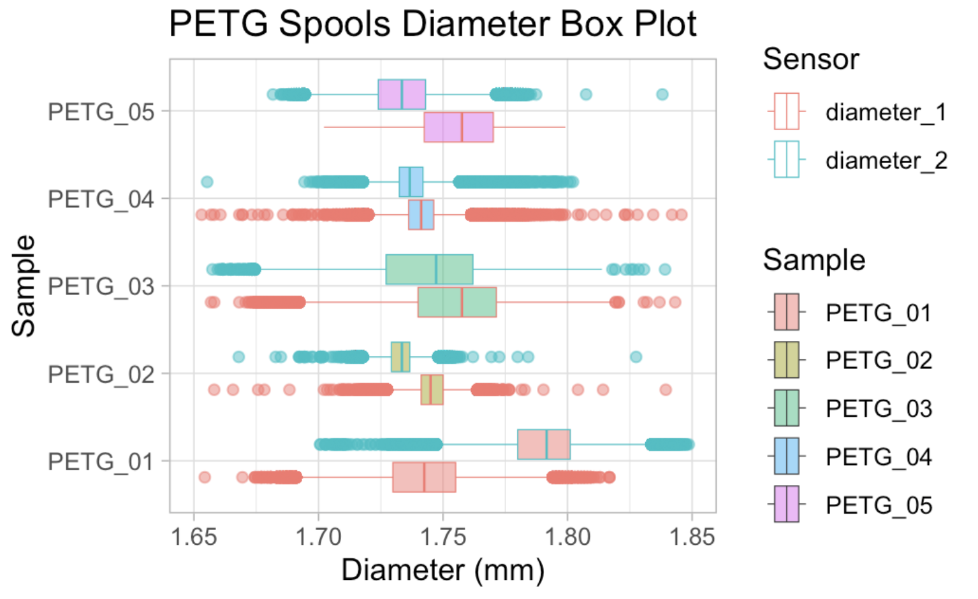
Probability of Success
Precision
Maximum Anticipated Variation: 0.1 mm
Minimum Anticipated Variation: 0.025 mm
Linear Rail Precision: Capable of achieving 0.1 mm accuracy without micro stepping
1/32 Micro step driver that gives maximum theoretical precision of 0.003mm
Outcome: Success
Micro step drive provided 0.003mm precision
Linear potentiometer provided absolute position data to account for backlash
[6] James, S. P., & Prawel, D. A. (n.d.). Biomaterials Research and Engineering Laboratory (BREL). Colorado State University, Department of Mechanical Engineering. Retrieved May 1, 2025, from
Notes:
Jacob

Slide 20
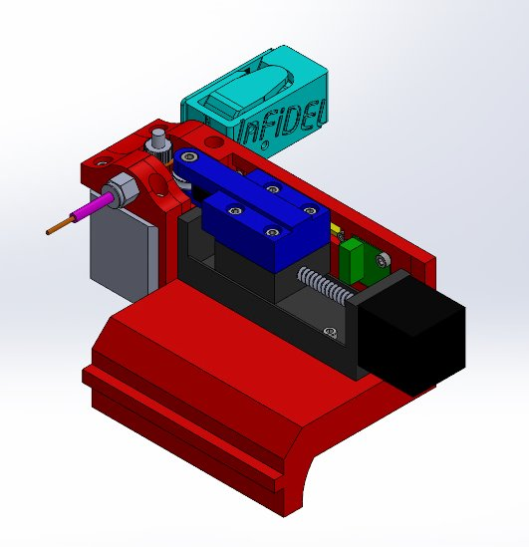
Probability of Success
Easy Assembly
No specialty tools required
No specialty manufacturing
4 unique 3D printed parts
Off the shelf components
Outcome: Success
Total parts: 47, including all mounting hardware
Simple assembly: Easy setup for user
Notes:
Jacob

Slide 21
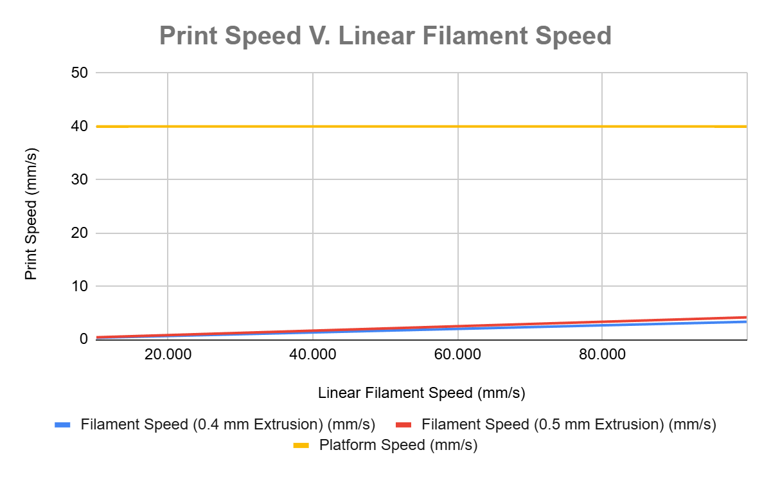
Probability of Success
Fast Response Time
Print Speed & Extrusion Rates (CURA slicer, 0.4 mm nozzle):
Print speed: 40-100 mm/s (typical range).
Extrusion rate: 3.84-9.60 mm³/s.
Linear filament speed:
At 40 mm/s print speed: 1.6 mm/s.
At 100 mm/s print speed: 4.0 mm/s.
Linear rail system: Maximum speed of 40 mm/s under a 3 kg load
Outcome: Success
Max linear speed of filament never greater than actuation speed
Compares measurements in both PID loops & actuate within 30 ms
Notes:
Jacob

Slide 22
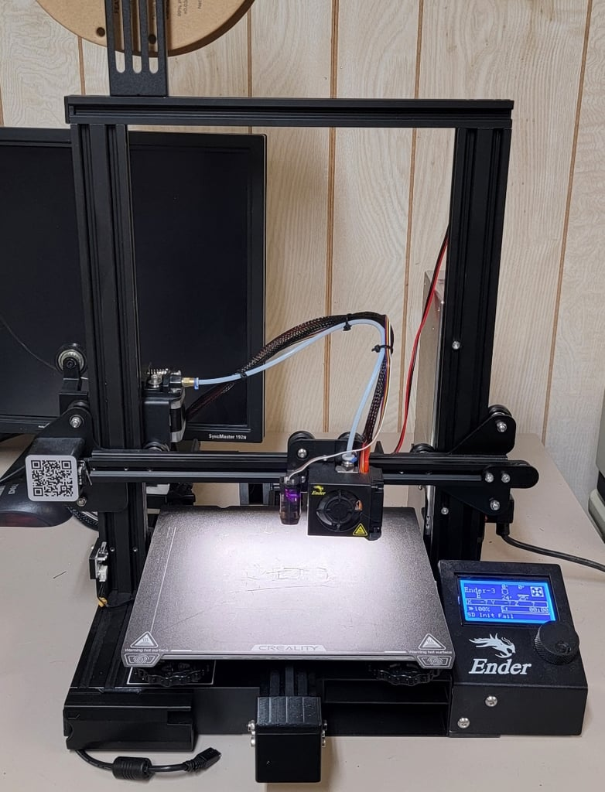
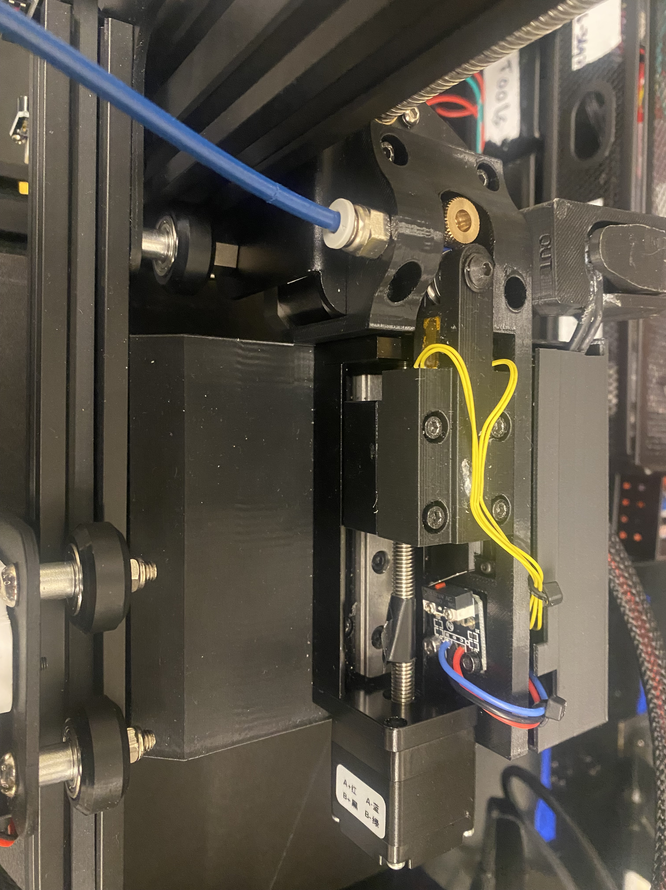
Probability of Success
Small Footprint & lightweight
Rotated device to be parallel with gantry bar
Current Weight of Gantry Bar: 800 - 1000 grams
Additional Weight of Assembly: 500 grams
Theoretical Lift Capacity of NEMA 17 Motor: 7,000 - 8,000 grams
Outcome: Success
Device fits inside printer footprint and does not weigh enough to damage Z stepper
[7] "3D Printable Ender 3 V2 Upgrade," Thingiverse. [Online]. Available: https://www.thingiverse.com/thing:6691542. [Accessed: Dec. 5, 2024].
Notes:
Jacob

Slide 23
Probability of Success
Maximize Lifespan
Redundant sensors and closed-loop control prevent collisions
Additional support attached to gantry bar reduces moment on Z – axis lead screw
Reduces vibrations from cantilever design
Outcome: Success
No collisions observed in testing
No change in vibrations with device
Notes:
Jacob

Slide 24
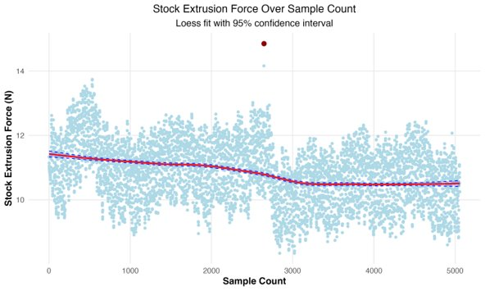
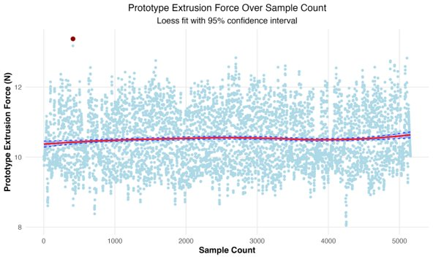
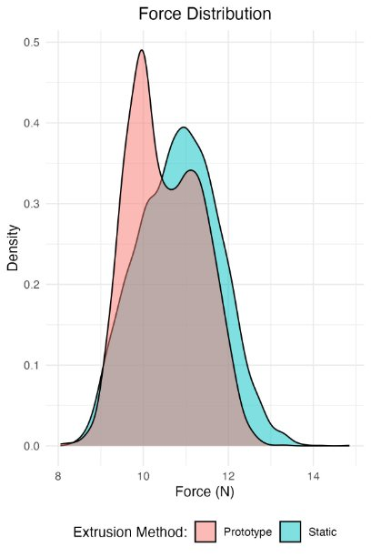
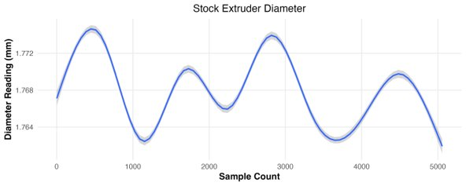
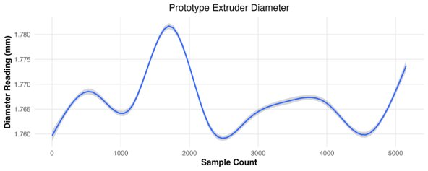
Data & Results
Force Testing
Static Extruder Key Points:
Sporadic changes in force
Mean: 10.84 N, Variance: 0.893 N, Range: 6.51 N
Prototype Extruder Key Points:
Consistent force band
Mean: 10.50 N, Variance: 0.706 N, Range: 5.33 N
Notes:
Sam

Slide 25
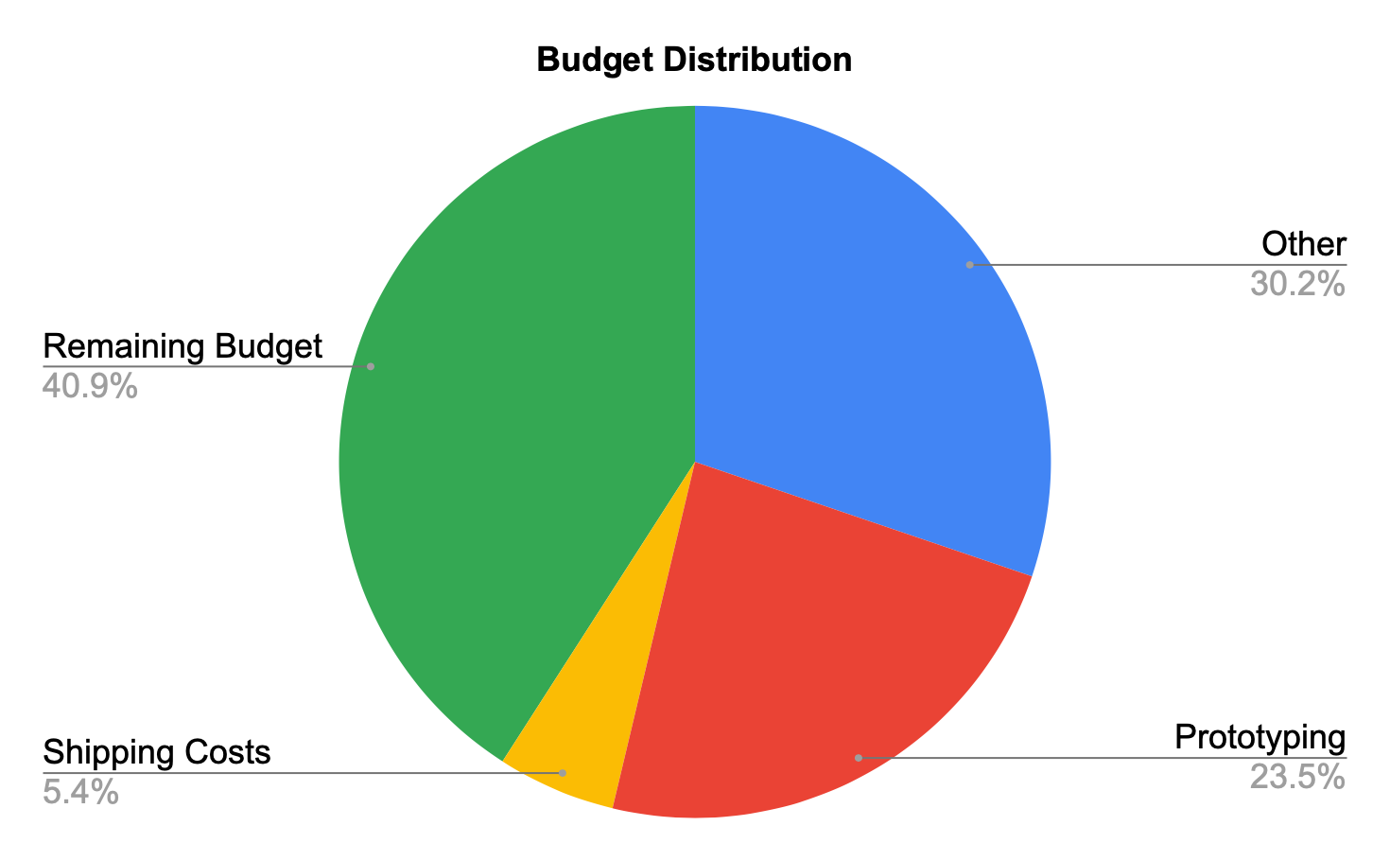
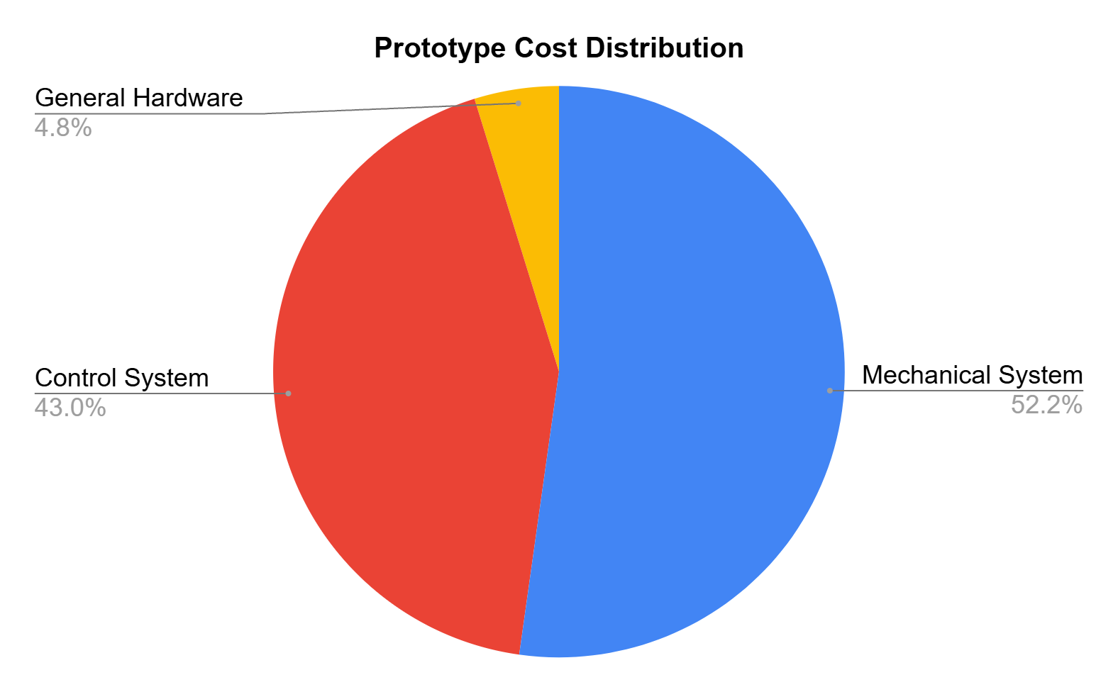
Budget
Total Spent: $2,659.29 ≈ 60% of total budget
$1,300 spent on 3d Printers & Filament
Total Prototype Cost: $122.57
Linear rail accounts for 50% of prototype cost
Notes:
Xander

Slide 26
Critical Path Flowchart
Start of Semester
1st 4 weeks
2nd 4 weeks
3rd 4 weeks
Mechanical System Prototype
Vibration Testing
Alpha Mechanical Prototype
Force Test System
Final Prototype
Finished System
(EDAYS)
Finalized Control System
Control System Prototype
Alpha Control System
Notes:
Brenner

Slide 27
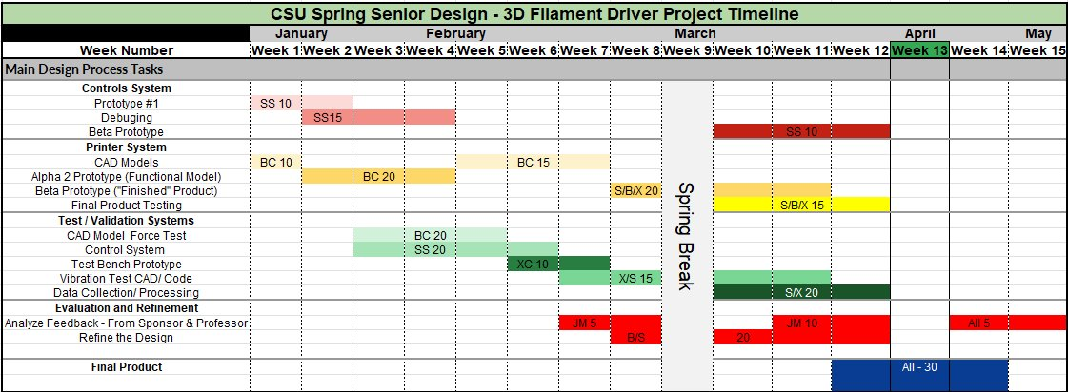
Gantt Chart
Notes:
Jacob

Slide 28
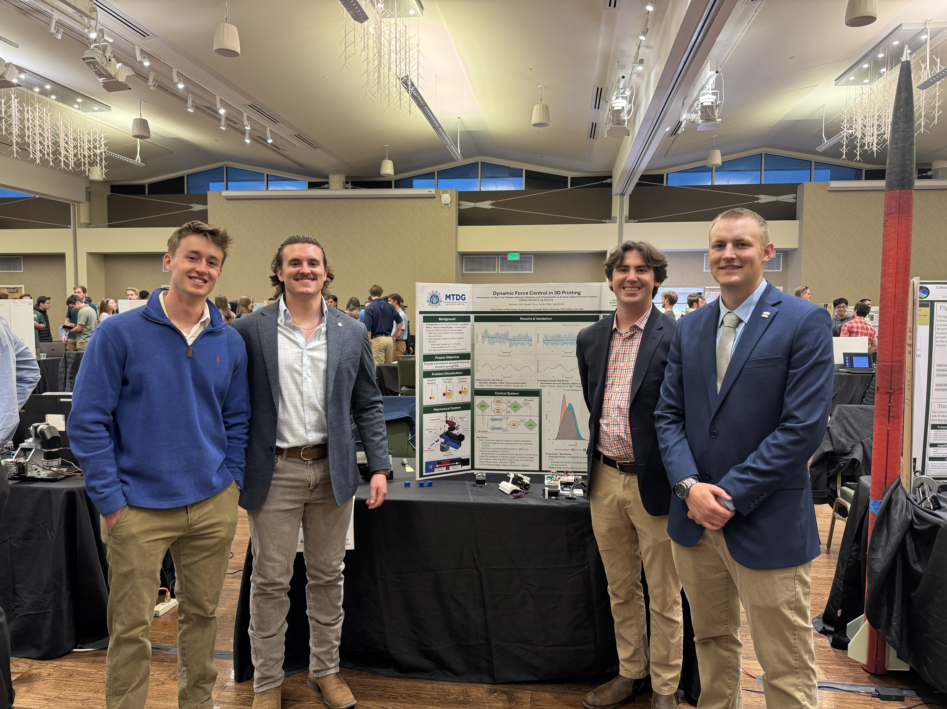
NEXT steps
Future Work
Integration with other BREL systems
Print quality & lifecycle testing
Custom fabrication to further reduce footprint
Adapt device for more advanced printers
Notes:
Xander

Slide 29
Conclusion
Problem Statement
Proposed Solution
Design For _____
Tradeoffs
Design Evaluation
Predicted Performance
Probability of Success
Schedule
Budget
Notes:
Sam

Slide 30
Questions?
Thank you
Notes:
Jacob

Slide 31
Appendix
Picture Sources
Semester 1 Gantt Chart
Semester II Gant Chart
Hose of Quality
BOM
Detail Drawings
Assembly Drawing

Slide 32
Picture Sources
[1] M. Boulaala, Basic Diagram of FDM 3D Printer Extruder. (a) Direct Extruder. (b) Bowden Extruder. Research Gate, 2020. https://www.researchgate.net/figure/Basic-diagram-of-FDM-3D-printer-extruder-a-Direct-extruder-and-b-Bowden-extruder-15_fig3_376519104
[2] "Linear Actuator Stepper Motor for CNC Milling Machine," Amazon. [Online]. Available: https://www.amazon.com/Linear-Actuator-Stepper-Milling-Machine/dp/B07K7FWDZJ?th=1. [Accessed: Dec. 5, 2024].
[3] “Arduino Nano,” Arduino Official Store, 2020. https://store.arduino.cc/products/arduino-nano?srsltid=AfmBOoq5md7oHKH53XCXMR7HcQrfkx_0XXJAZi-3u9X6VRjrlWzu-RHk (accessed May 01, 2025).
[4] Culler. Strain Gauge Used in Mechanics Experiment for Material, Industry, or Science. Amazon, n.d., www.amazon.com/dp/B07P8HBPGR.
[5] SparkFun Electronics. Load Cell - 10kg, Straight Bar (TAL220). SparkFun Electronics, n.d., https://www.sparkfun.com/load-cell-10kg-straight-bar-tal220.html. Accessed 1 May 2025.
[6] James, S. P., & Prawel, D. A. (n.d.). Biomaterials Research and Engineering Laboratory (BREL). Colorado State University, Department of Mechanical Engineering. Retrieved May 1, 2025, from
[7] "3D Printable Ender 3 V2 Upgrade," Thingiverse. [Online]. Available: https://www.thingiverse.com/thing:6691542. [Accessed: Dec. 5, 2024].

Slide 33
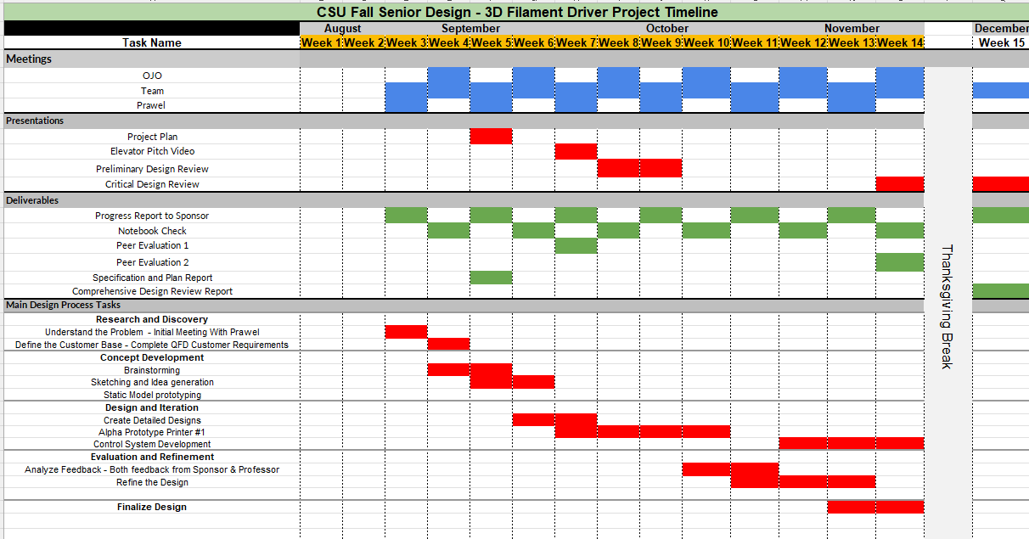
Original Schedule
Notes:
Jacob

Slide 34
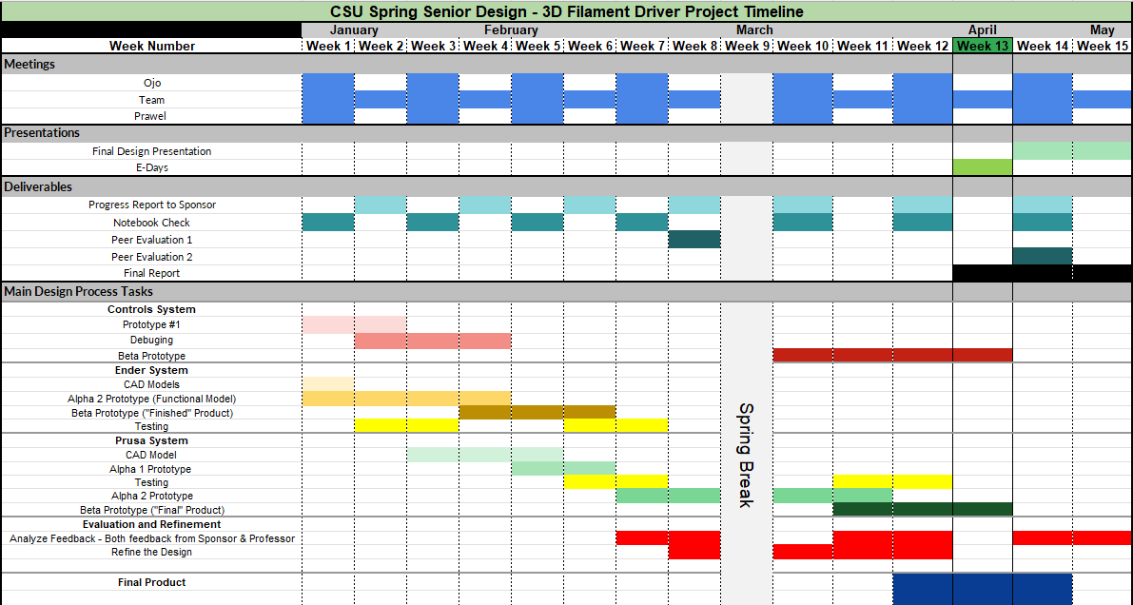
Beginning of 2nd Semester Schedule
Notes:
Jacob

Slide 35
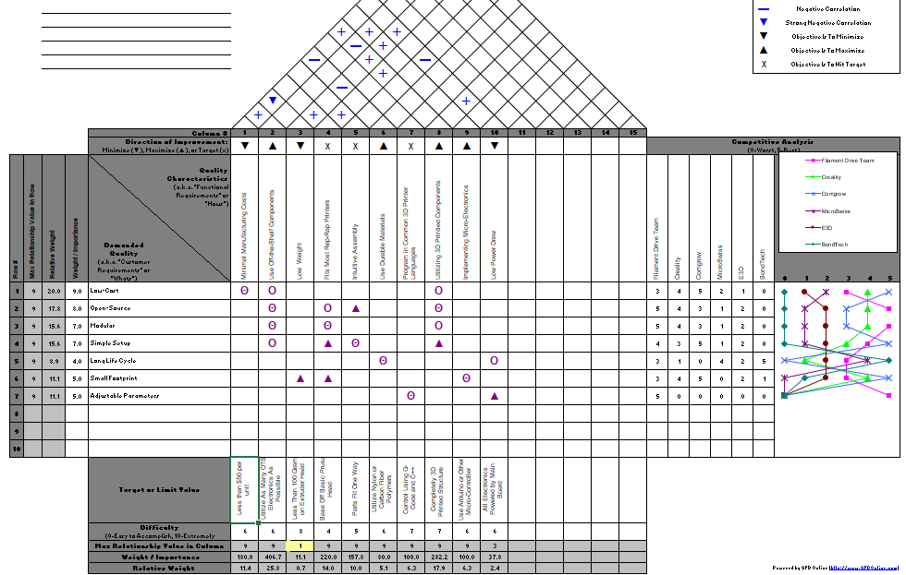
House of quality

Slide 36
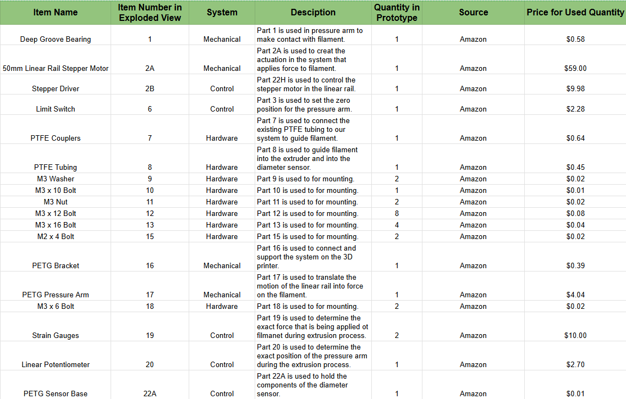
Final Bill of materials 1

Slide 37
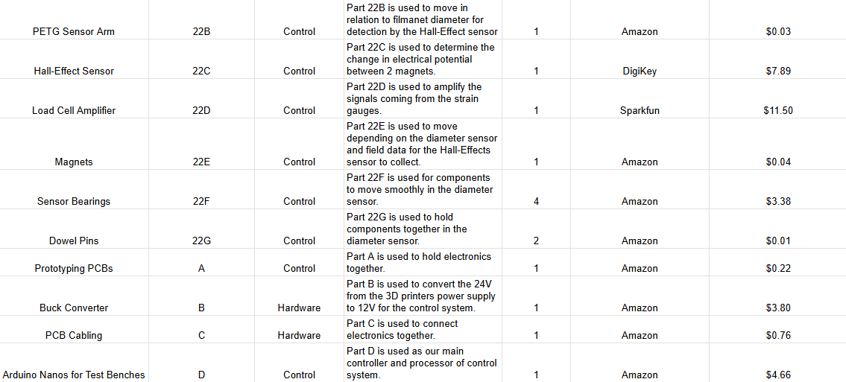
Final Bill of materials 2

Slide 38
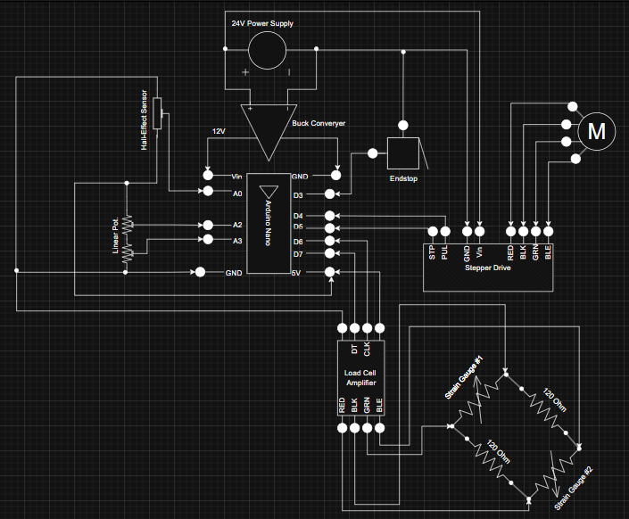
Detail Drawing
Wiring Diagram

Slide 39
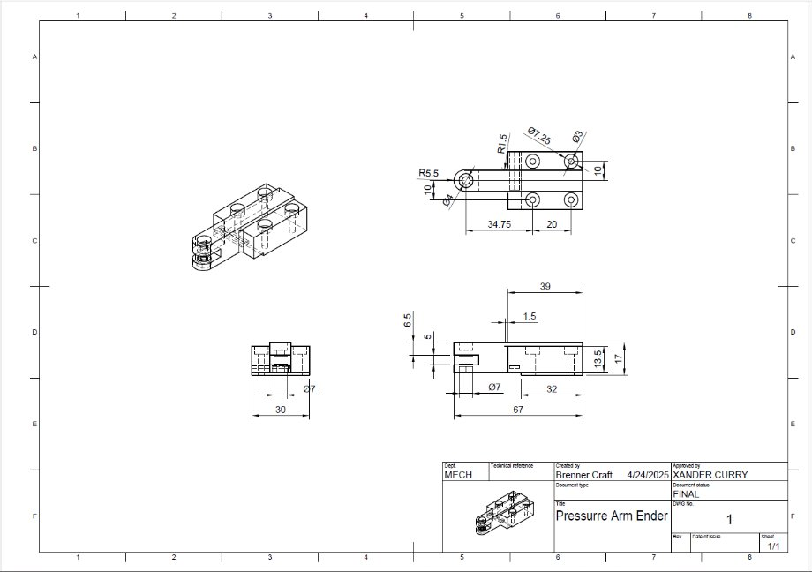
Detail Drawing
Pressure arm

Slide 40
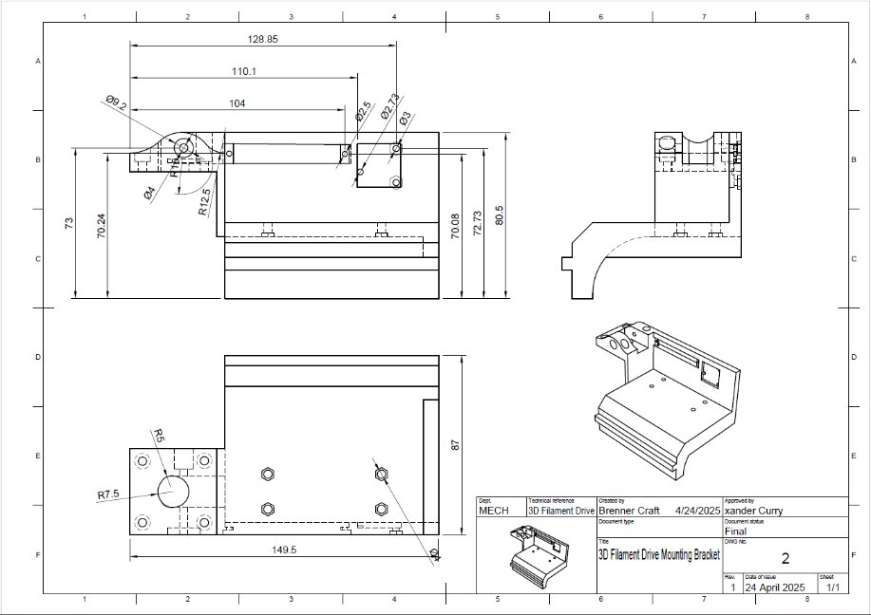
Detail Drawing
Mounting Bracket

Slide 41
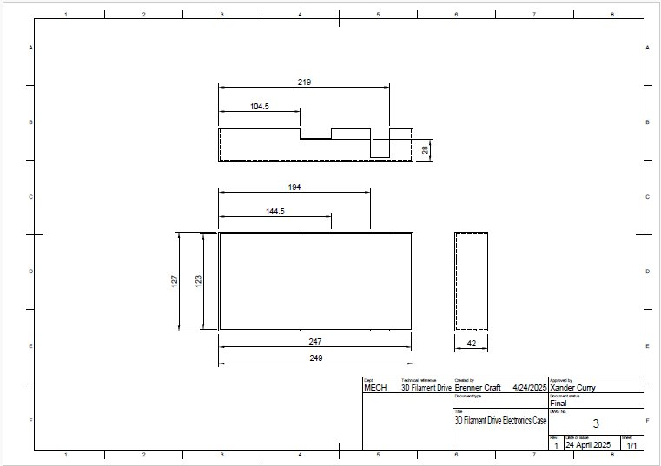
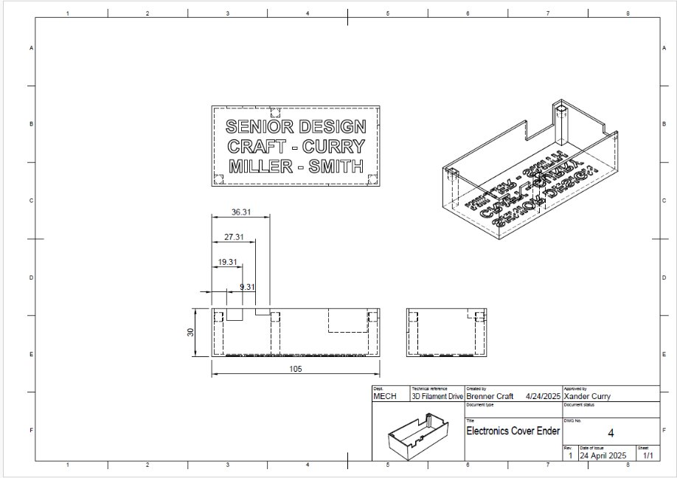
Detail Drawing
Electronics Housing

Slide 42
Detail Drawing
Exploded View

Slide 43
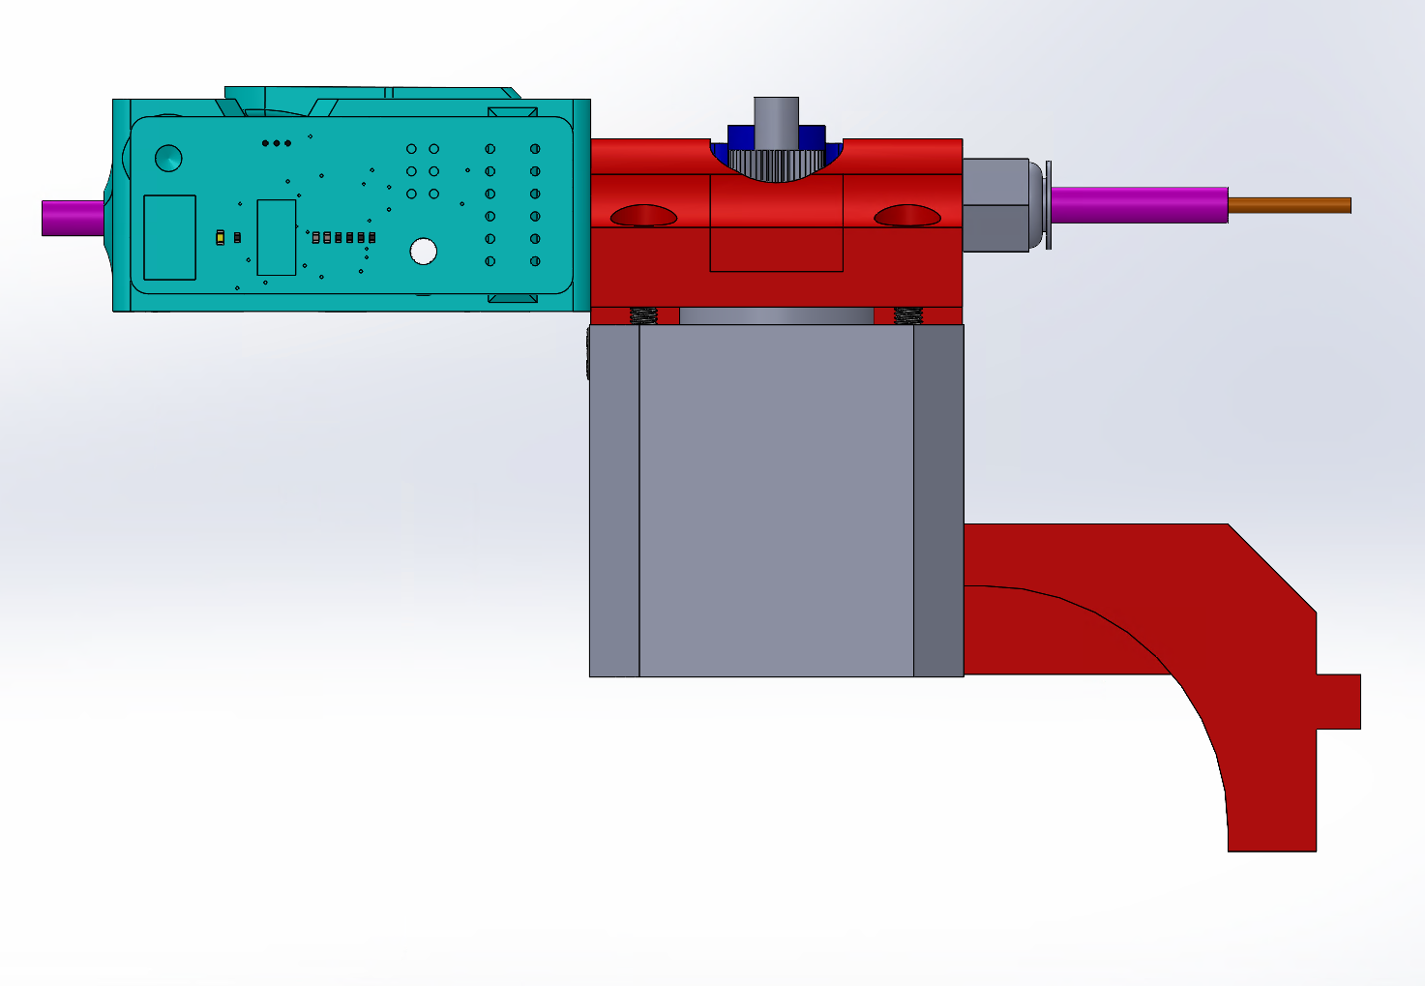
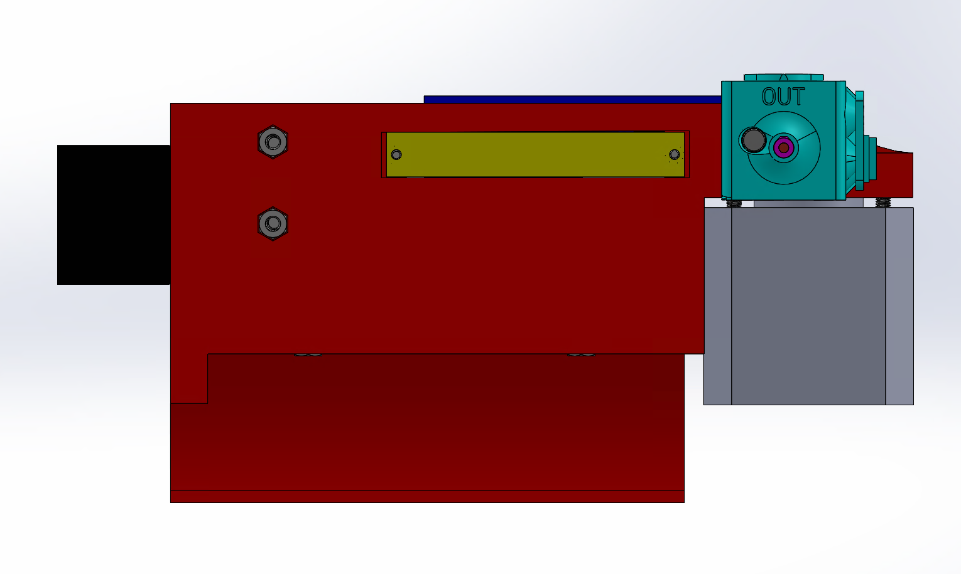
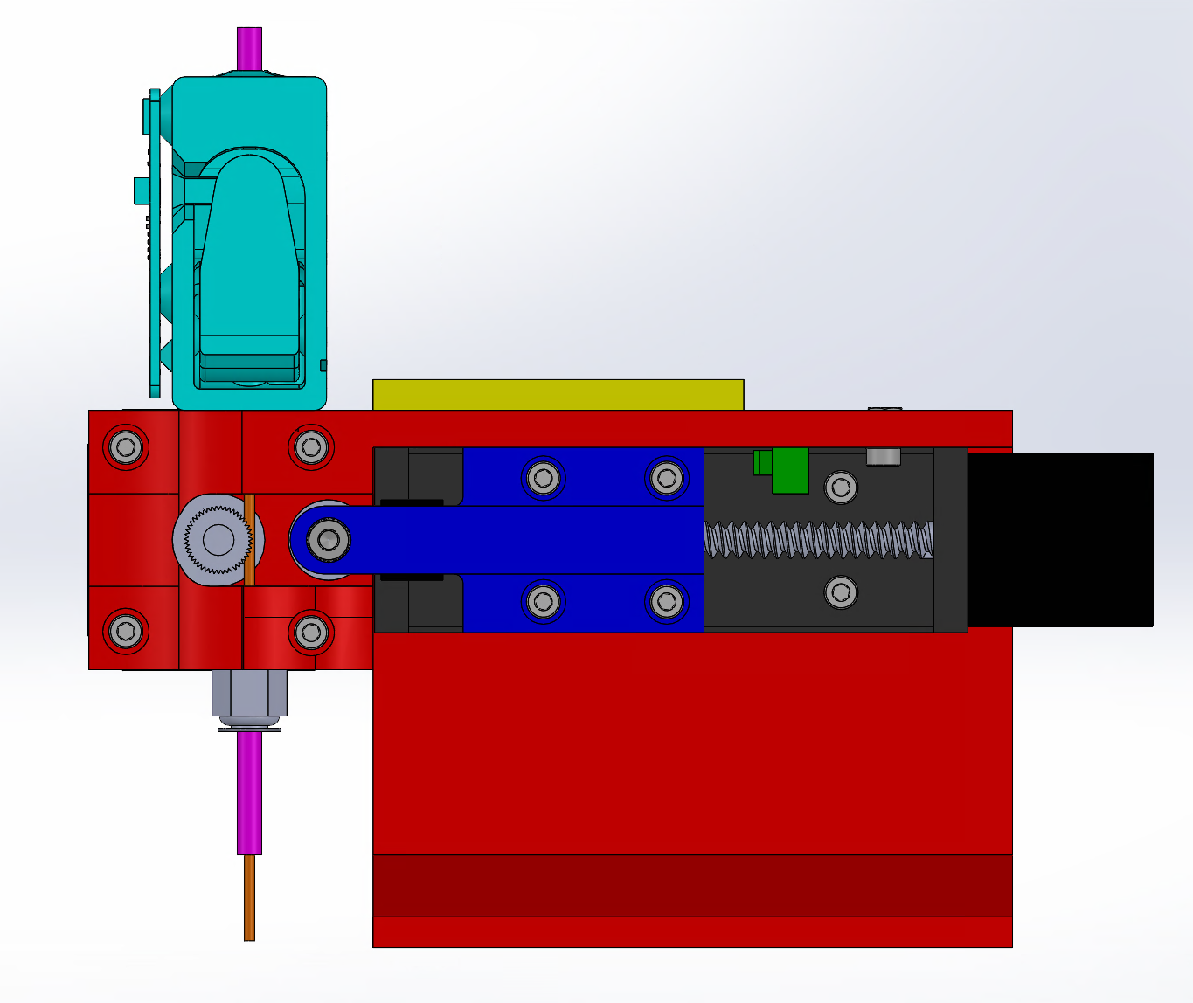

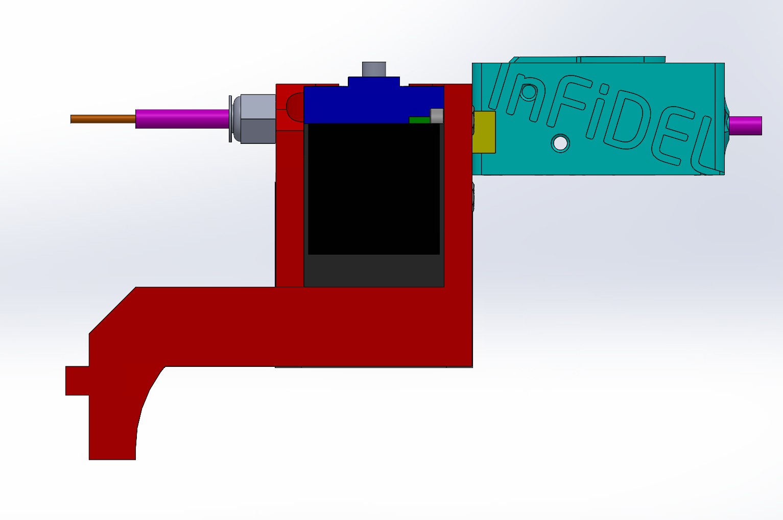
Extra Pictures
AA

